Slide 1

APARTMENT MANAGEMENT SYSTEM
-Sakshil Verma(RA1911031010071)-team lead
-Saksham Thareja(RA1911031010065)-member
-Akarshit Vats(RA1911031010066)-member

Slide 2
INTRODUCTION TO OUR SOFTWARE
Apartment Management System is a basic and ideal way to manage, maintain, communicate and even share your ideas within your residential complex or society.
It will have different user roles like the Admin ,Secretary ,Resident Members , Gatekeeper and even Accountant Users.
The software would be having a very simple and basic interface so that the elderly or even the less educated people can use it with ease.

Slide 3
A Basic Idea of Our Software
It will have different user roles like the Admin ,Secretary ,Resident Members , Gatekeeper and even Accountant Users.
The software would be having a very simple and basic interface so that the elderly or even the less educated people can use it with ease.

Slide 4
Feature Set of the Software
A Dashboard
Facilities Management
Maintenance Committee
Notices Section
Management Committee
Member Management
Complain Management
Parking Manager

Slide 5
Project Methodology
A project management methodology is essentially a set of guiding principles and processes for managing a project. Your choice of methodology defines how you work and communicate.
We have chosen Agile methodology for our project because of the following reasons:
Superior quality product.
Customer satisfaction.
Better control.
Improved project predictability.
Reduced risks.
Increased flexibility.
Continuous improvement.
Improved team morale.

Slide 6
AGILE METHDOLOGY Explained
The Agile software development methodology is one of the simplest and effective processes to turn a vision for a business need into software solutions. Agile is a term used to describe software development approaches that employ continual planning, learning, improvement, team collaboration, evolutionary development, and early delivery. It encourages flexible responses to change.
The agile software development emphasizes on four core values.
1) Individual and team interactions over processes and tools
2) Working software over comprehensive documentation
3) Customer collaboration over contract negotiation
4) Responding to change over following a plan

Slide 7
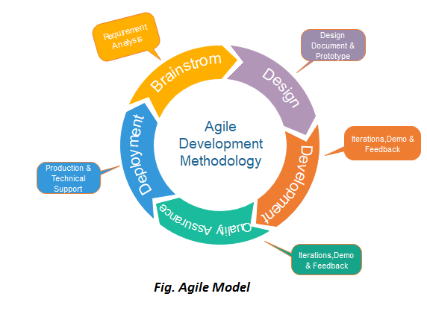
AGILE MODEL STEPS

Slide 8
STAKEHOLDER MANAGEMENT
Who is a Stakeholder?
A stakeholder is an individual, group, or organization that may affect be affected by or perceive itself to be affected by a decision, activity, or outcome of a project.
Who all are stakeholders in our project?
Our project development has 3 main hierarchical positions one of us being the project steering committee leader and two of us being members.
Sakshil Verma – Project steering committee leader
Saksham Thareja - Project steering committee member
Akarshit Vats- Project steering committee member

Slide 9
MAJOR FUNCTIONS
Personal Login(Member Management) & New Registration Module
Complaints Register Module
Facilities Management Module
Notice Section Module
Management Committee Module
Parking Management Module
New Initiatives Module
Product Improvement Suggestions Module

Slide 10
REQUIREMENTS
There are three types of requirements :
1) Functional Requirements
2) Non-Functional Requirements
3) Infrastructural Requirements

Slide 11
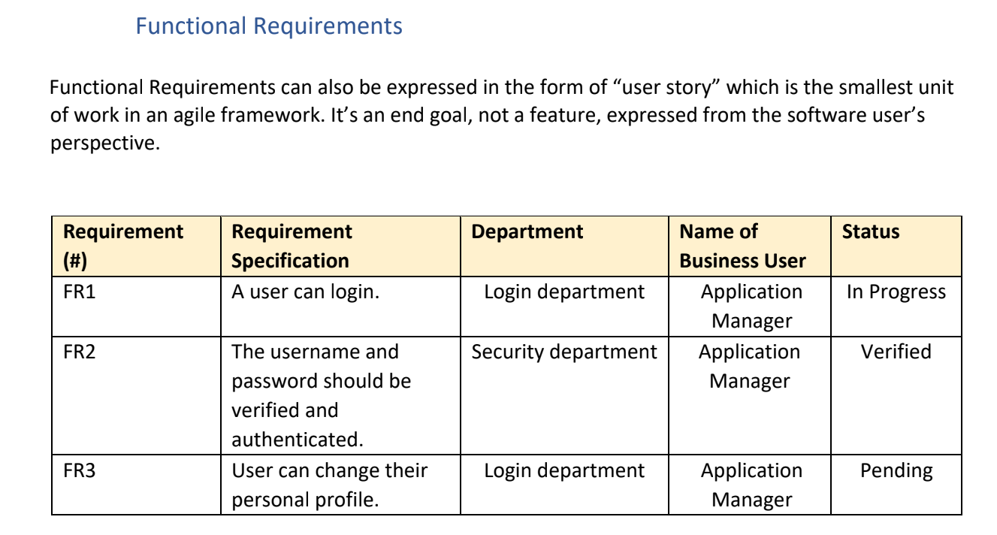
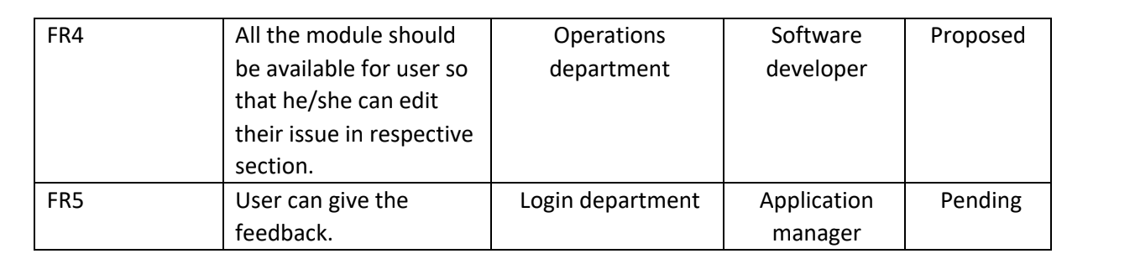
FUNCTIONAL REQUIREMENTS

Slide 12
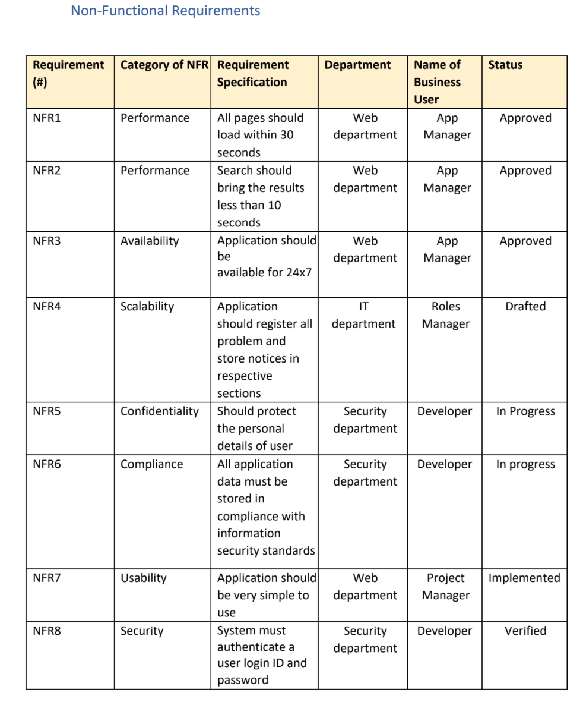
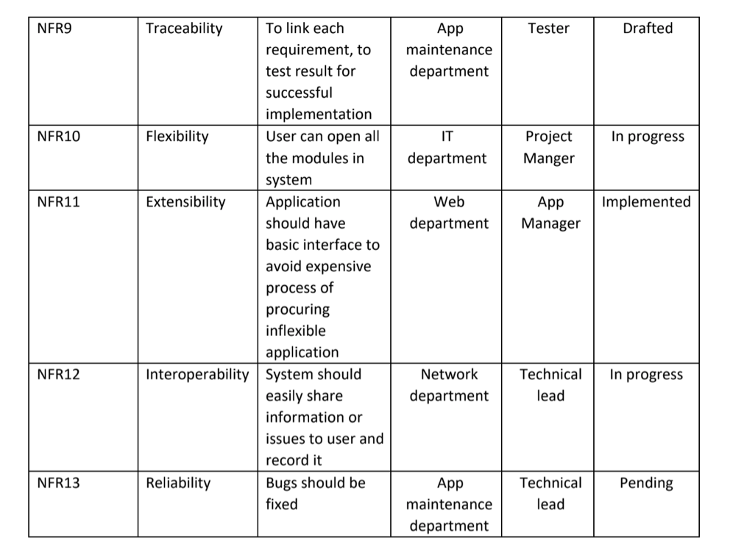
NON-FUNCTIONAL REQUIREMENTS

Slide 13
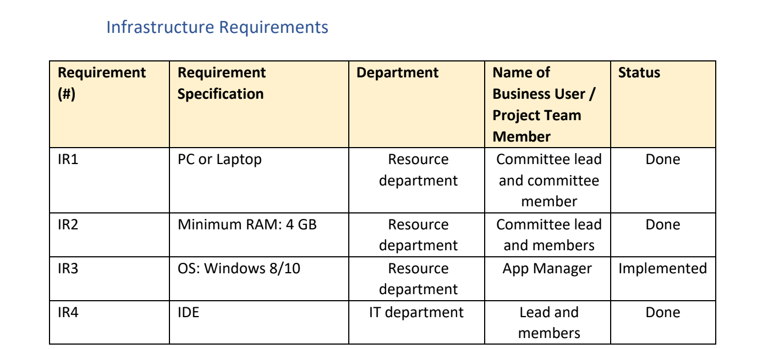
INFRASTRUCTURE REQUIREMENTS

Slide 14
PROJECT MANAGEMENT PLAN
The following are the main focus areas in our management plan for the project:
Integration Management
Scope Management
Schedule Management
Cost Management
Quality Management
Resource Management
Stakeholder
Communication Management
Risk Management
Procurement Management

Slide 15
ESTIMATION
In the estimation section we basically have three subsections for easy of use :
Effort and Cost Estimation
Infrastructure/Resource Cost
Maintenance and Support Cost

Slide 16
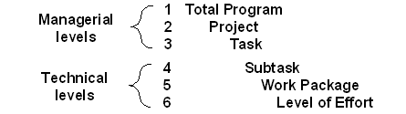
WBS and Risk Management Plan
A Work Breakdown Structure (WBS) is a deliverable-oriented hierarchical decomposition of the work to be executed by the project team to accomplish the project objectives and create the required deliverables. A WBS is the cornerstone of effective project planning, execution, controlling, monitoring, and reporting.
The WBS can help the team identify and eventually analyze these risks and is an effective tool for identifying specific risks. By looking at the WBS, the risk management team can go through each task in the WBS and identify specific events that can lead to risks relating to each task.
A Full WBS Structure basic diagram:

Slide 17
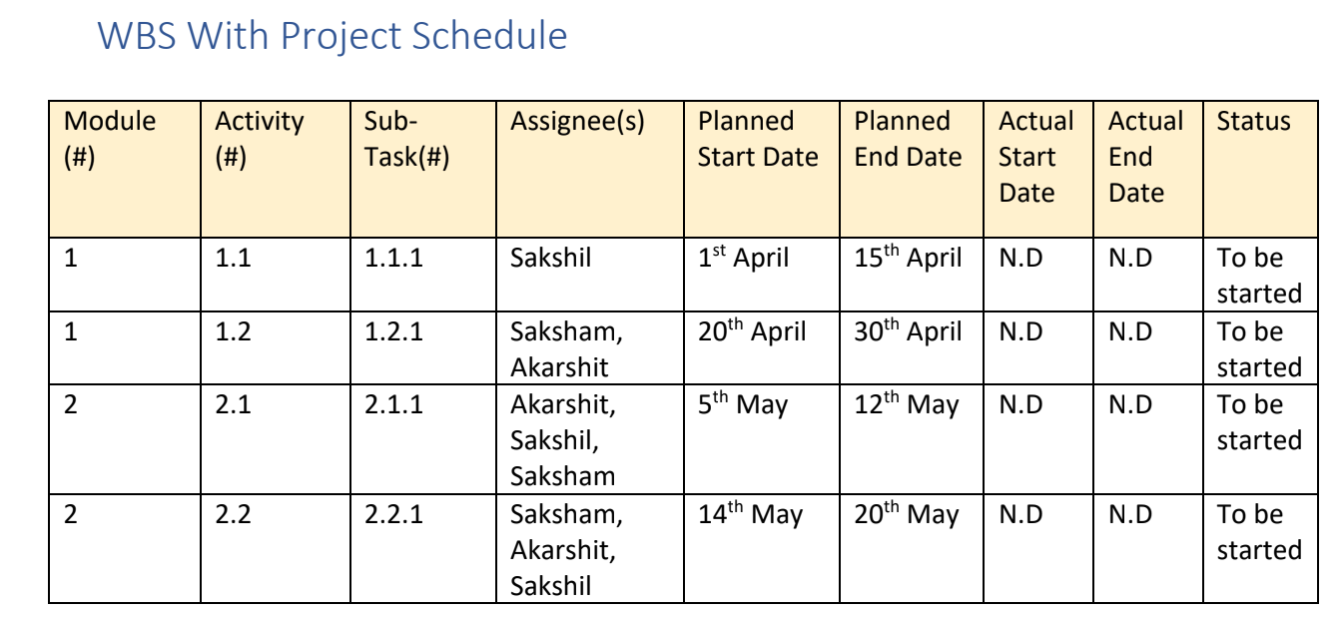
WBS With Project Schedule

Slide 18
Risk identification AND MANAGEMENT
Risk identification is the process of determining which risks may affect the project and documenting their characteristics. The key benefit of this process is documentation of existing risks and the knowledge and skills offered by the project team anticipate risk events.
Project risk management is the process of identifying, analyzing and responding to any risk that arises over the life cycle of a project to help the project remain on track and meet its goal. Risk management isn’t reactive only; it should be part of the planning process to figure out risk that might happen in the project and how to control that risk if it in fact occurs.

Slide 19
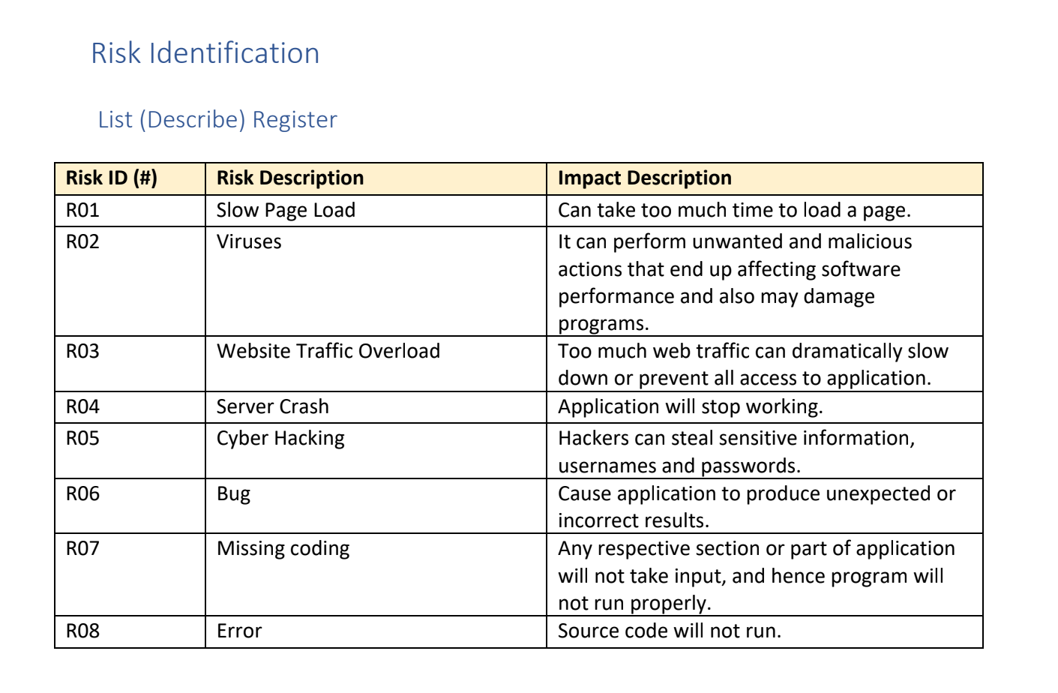
LIST REGISTER

Slide 20
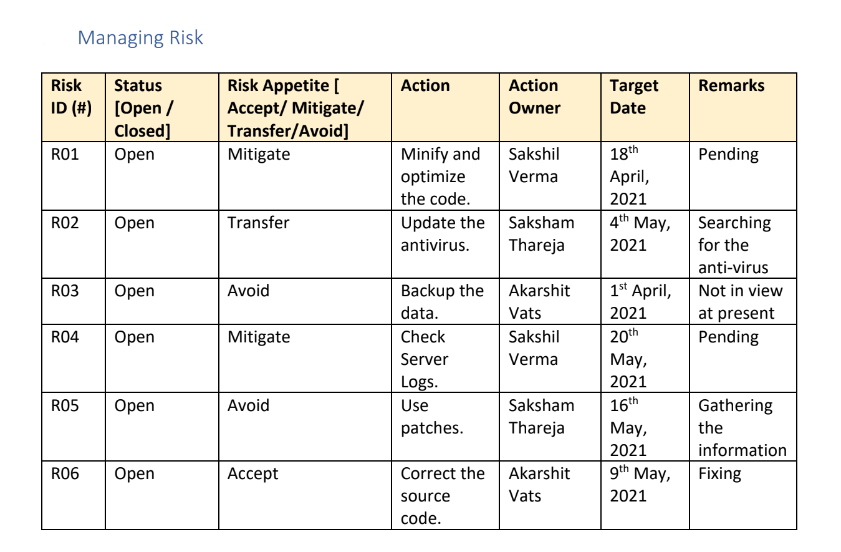
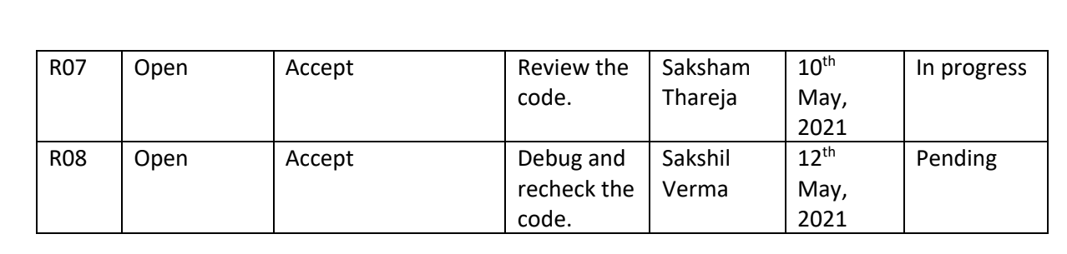
MANAGING RISK

